Slide 1


Impact of Science Conference the Parallel Session on:
Training and Skills for Impact
23rd June, 2021

Slide 2


Impact of Science
23-25 June, 2021
Overview of the Speakers
Wendy Cukier (Chair): Diversity Institute Founder, Academic Director of the Women Entrepreneurship Knowledge Hub and Research Lead of the Future Skills Centre, Canada
Sarah Morton: Director of Matter of Focus & Honorary Fellow at University of Edinburgh, Scotland
Angus Paterson: Managing Director of South African Institute for Aquatic Biodiversity, NRF, South Africa
#IOS21

Slide 3
Impact of Science
23-25 June, 2021
Wendy Cukier
Diversity Institute Founder, Academic Director of the Women Entrepreneurship Knowledge Hub and Research Lead of the Future Skills Centre, Canada
#IOS21

Slide 4


Training and Skills for Impact
Wendy Cukier, MA, MBA, PhD, DU (hon) LLD (hon) M.S.C.
wcukier@ryerson.ca
Founder & Academic Director, TRSM Diversity Institute
Professor, Entrepreneurship & Strategy, Ryerson University
@CukierWendy

Slide 5

CONTEXT
What is Research Impact? identifiable benefit or positive influence for the economy, society, public policy or services, culture, the environment or quality of life (HEFCE, 2010)
Delivering highly skilled people;
Creating new businesses, improving the performance of existing businesses, or commercialising new products or processes;
Attracting R&D investment from global business;
Better informed public policy-making or improved public services;
Improved patient care or health outcomes;
Progress towards sustainable development, including environmental sustainability;
Cultural enrichment, including improved public engagement with science and
research;
Improved social welfare, social cohesion or national security;
Other quality of life benefits.
IT VARIES BY DISCIPLINE BUT THIS IS SELDOM TAUGHT AS PART OF
RESEARCH TRAINNG
1

Slide 6
Research Excellence vs. Relevance/Impact
Research relevance and impact is real change in the real world.
There are many different kinds of impact including attitudinal,
awareness, economic, social, policy, cultural and health.
It takes hard work and persistence and specific knowledge and skills to create impact from research
Understand relevant audiences to discover, connect with, understand,
apply and advocate for research.
Ideally stakeholder engagement throughout the lifecycle
Evidencing and measuring impact are controversial and fast
developing areas
Current systems tend to pay lip service to impact but reward
traditional measures - eg “impact factors” versus impact
2

Slide 7


RETHINKING INNOVATION
Innovation is doing differently
There is no innovation without users and
adoption
Arts and Social Sciences are essential to
understanding barriers and drivers
"Creativity is thinking up new things.
Innovation is
doing new
things.”
–Theodore Levitt
Microsoft believes that lessons from a
liberal arts education are necessary
for the proper development of AI.
Justin Sullivan/2019"The Future Computed,"
3

Slide 8
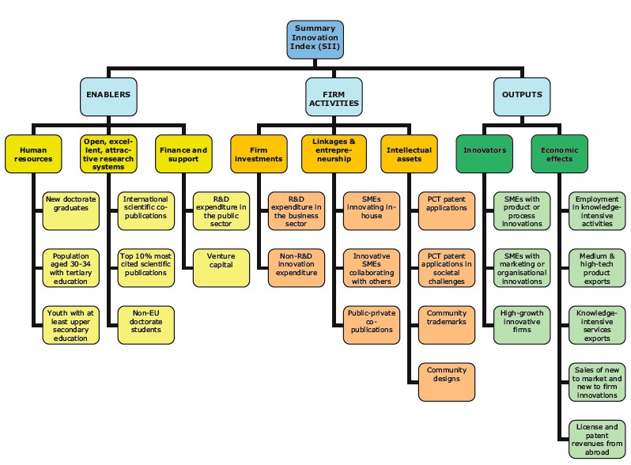

Dominant Frameworks of Innovation: Narrow Focus
Innovation performance at different income levels, 2020: UK, Canada (barely) and South Africa are above expectations for income level (WIPO, 2020)
4

Slide 9


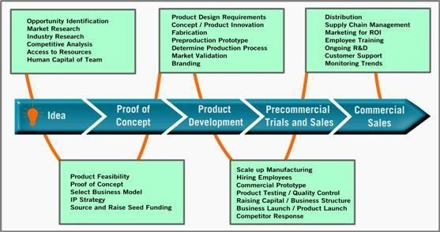
Traditional University Research “Impact”
$
5

Slide 10
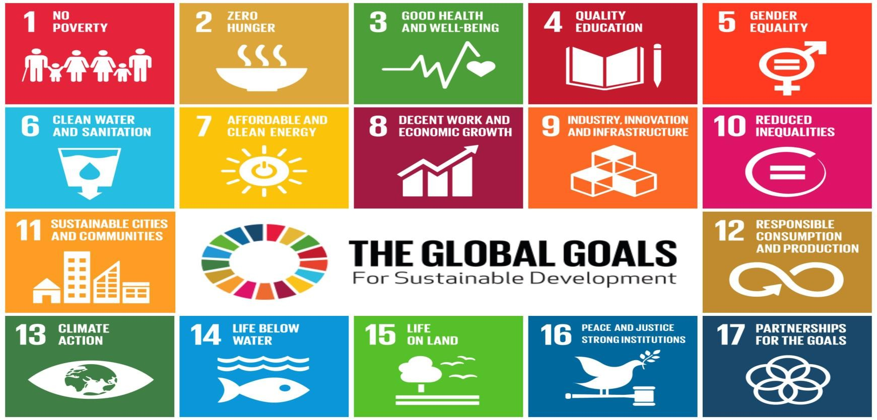
Not Just Economic: The “World’s to do list”
6

Slide 11
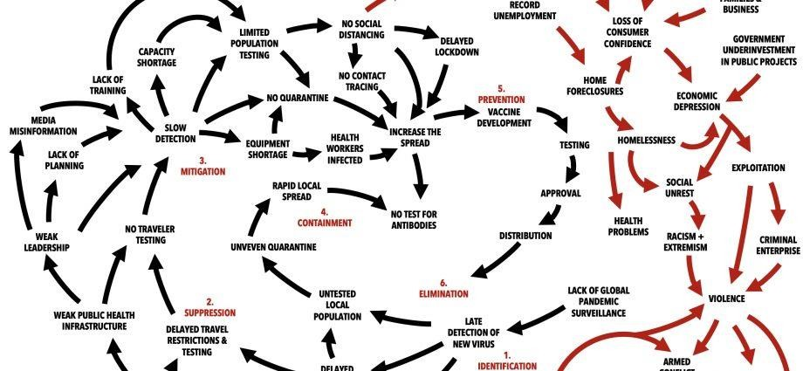
Mapping COVID-19 as a Wicked Problem
IN: COVID-19, HATE & EXTREMISM, INEQUALITY, VIRTUOUS SOLUTIONS, WICKED
PROBLEMS CHRISTIAN SARKAR & PHILIP KOTLER
77

Slide 12
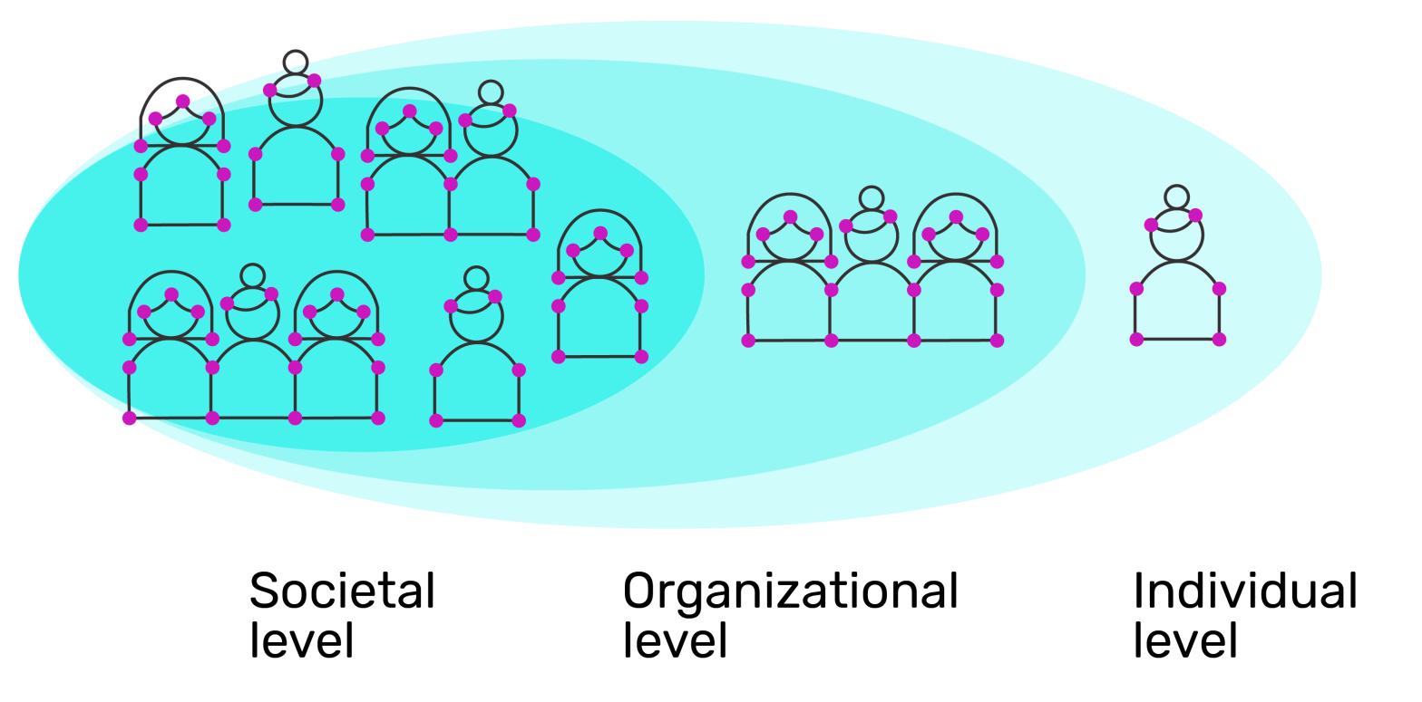
ECOLOGICAL MODEL OF CHANGE

Slide 13
Societal Level
Investments in research and innovation which prioritize impact
Adjudication structures and processes which value impact
Ecosystem structure and linkages
Rethinking definitions of innovation
Not just IP or even job creation - SDGs: gender equality,
environment, etc
Diversity and inclusion lens
Reward systems

Slide 14
Institutional level
Culture of the ivory tower
Inclusion (not just STEM!)
Reward systems
Celebrating success
Innovative approaches to engaging with stakeholders
Tools for design, implementation and KMB
Skills and capacity building
Assessment and accountability frameworks

Slide 15
Individual Level
Research Impact Training
What are the potential impacts
of research?
How to create societal impact
from research?
Pathways and approaches
Models for KMB
Skills for creation
communication, collaboration
Tools and techniques – theories of change, logic models, evaluation frameworks, storytelling
Knowledge and Skills – management, financial, technological
Confidence
Access to resources - $,
human and social capital
Satisfaction and perceptions of
success
Narratives and story telling
1111

Slide 16
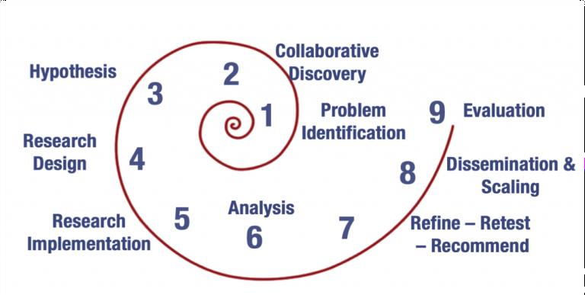
Impact Thinking Mindset
(International Arts + Mind Lab at Johns Hopkins University)
12

Slide 17
To impact the real world you need to understand it……..
Work integrated learning Applied research Incubators and accelerators Hackathons
Community engagement
Service learning
More focus on impact also opens more spaces for diversity and inclusion.
Innovation often occurs on
Context
Complex systems
Crossing Disciplines
Collaboration
Consultation
Community connectedness
Cross cultural awareness
Communication
Creativity
the periphery
13

Slide 18
Tracking a wider range of impacts
PURPOSE
Inclusive entrepreneurship Community improvements Economic development Industry strength Globally competitive
Sustainable Development Goals
INPUTS ACTIVITIES IMPACT ON CHANGE
Knowledgeable
people
Relationships
Equipment,
facilities
Funding
Participating clients
Data and evidence
Research
Assess Needs
Training
Advising
Funding
Mentoring
Peer to Peer Support
Events, conferences, seminars, meetings
Websites, blogs,
reports, newsletters
Networking
Evaluation
CSR
Define and share
best practices
Capacity Building
Economic
Social-Cultural
Impact on Change in:
Knowledge, expertise
Opportunities for promotion, influence
Business and
research linkages
Access to technology services
Access to financing
Access to complementary business inputs
Access to supports for
diverse groups
Impact on Change in:
Products, services
Time to market
Market share
Employment
Environmental impact
Revenues
Valuation
Investment
Export
Ecosystem connections
Skills development
Impact on Change in:
Sustainable wealth and jobs
Environmental and health care improvement
Increased community, regional, national, economic and social wellness
Sustainable Development Goals
Infrastructure
Gender equality and inclusion for under- represented groups
14

Slide 19

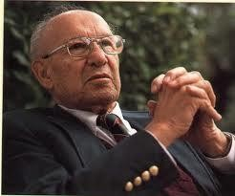
Qualitative AND Quantitative Assessments
“Not everything that counts can be measured. Not everything that can be measured counts.”
Albert Einstein
“What gets measured gets done.”
Peter Drucker
Citations, Commercialization, Public Engagement, Policy Impacts, Organizational Change, Knowledge and Behavioral Change…….
Storytelling matters!

Slide 20
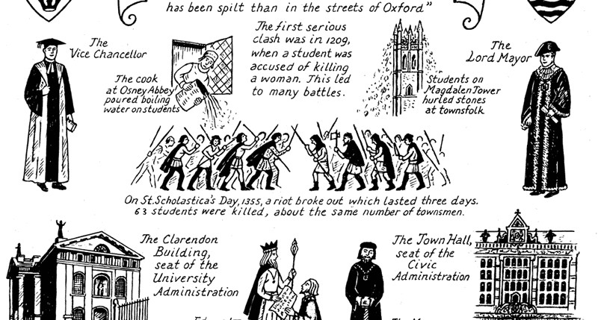
END 500 YEARS OF CULTURE WARS
KNOWLEDGE
THE
ECONOMY
“Corporatizatio n of the university” “Preserve Academic
Freedom”
VERSUS
We need both Excellence
+
Relevance for Impact
“Liberal Arts are useless” “Universities are irrelevant”

Slide 21

Wendy Cukier
ryerson.ca/diversity diversityinstitute@ryerson.ca @RyersonDI
416-979-5000 x6740
Director, Diversity Institute
wcukier@Ryerson.ca

Slide 22
Impact of Science
23-25 June, 2021
Sarah Morton
Director of Matter of Focus & Honorary Fellow at University of Edinburgh, Scotland
#IOS21

Slide 23
Improving the impact of science: tools and skills
Taking the challenge of understanding our unique contribution
Dr Sarah Morton,
Director, Matter of Focus
and Honorary Fellow, University of Edinburgh
Notes:
Matter of Focus is…

Slide 24
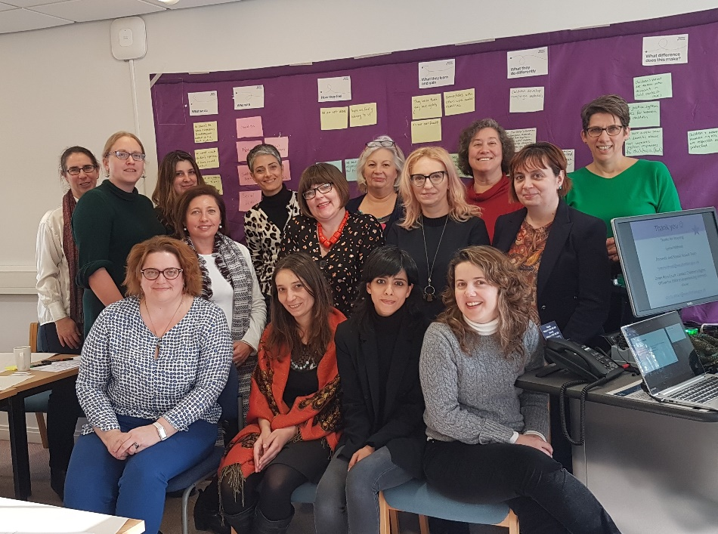
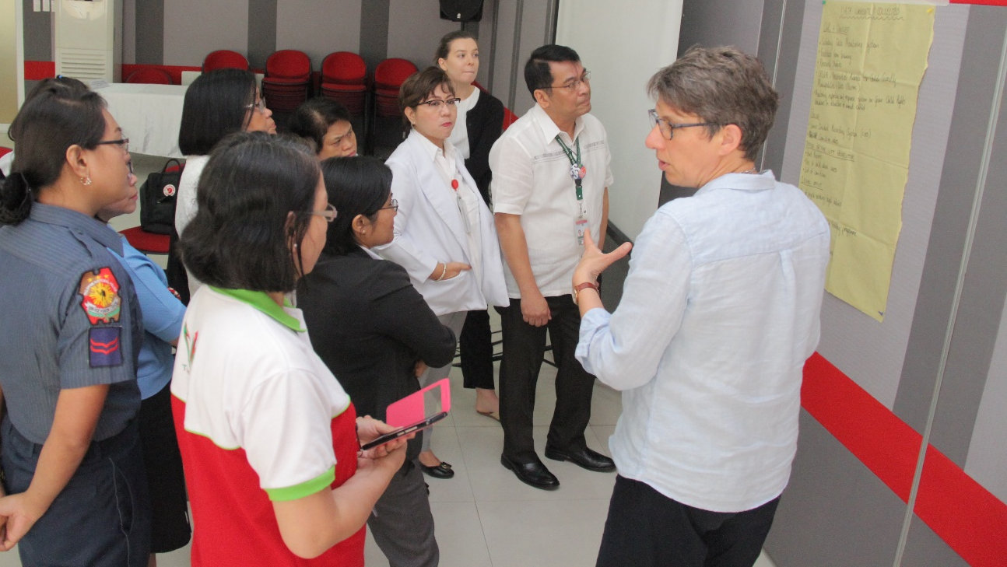
The starting point
Notes:
I have been working in the field of Knowledge mobilisation formally since 2001 University of Edinburgh – KMB then Director, and informally before that with policy-influencing work that often rested on research.
I have been involved in policy and practice influencing, coproduction and traditional research dissemination.
I took a mid-life PhD starting in 2008 because I became really concerned with the topic of how we know that all of this work makes a difference to people and communities.
My PhD looked at what is research impact, and how can it be assessed.
That led to further involvement in the REF impact case studies at UoE, to training people in impact,
and to carrying out 7 independent impact studies of different initiatives in various parts of the world and on several different topics
So the starting point for this presentation is that I really want to make a difference, and I think that in this community most of us do
Our company Matter of Focus does this through tailored support and our software OutNav
But it is challenging to actually do this in a meaningful way, as I will go on to explore through this talk

Slide 25
What do we need to effectively design and implement impact strategies?

Slide 26
Three elements of any new practice
Materials
Objects
Technologies
Meanings
Ideas
Aspirations
Competencies
Skills
Know-how Technique
After Shove et al (2012)

Slide 27
Unpicking the concepts
Research uptake: people are interested in research, read it, talk about it, go to a presentation, event etc..
Research use: people do something with the research, change their view, pass it on to someone else, ‘apply it’ to practice or policy
Research impact: a contribution to change as a result of research use
Morton (2015)
Notes:
For this reason, the term ‘research uptake, use and impact’ is used to describe the processes of research utilisation and their link to impact, which is open to any kind of use on the instrumental/conceptual spectrum. The term ‘uptake’ refers to the successful engagement of potential research users with research, and is a commonly used measure of impact (Scottish Funding Council 2006). This means that research users have engaged with research: they have read a briefing; attended a conference or seminar; or engaged in some other kind of activity which means they know the research exists. This is obviously a prerequisite of any kind of research use, which means then applying the research to some kind of policy or practice setting. Again use is a prerequisite of that research creating any change in the given setting. The term ‘research uptake, use and impact’ then, sets out a process-orientated definition of research utilisation, and implies a pathway of engagement, activity and change, that creates impact.
Process orientated definition.
Research uptake: research users have engaged with research: they have read a briefing, attended a conference or seminar, were research partners, were involved in advising and shaping the research project in some way, or engaged in some other kind of activity which means they know the research exists.
Research use: research users act upon research, discuss it, pass it on to others, adapt it to context, present findings, use it to inform policy, or practice developments.
Research impact: changes in awareness, knowledge and understanding, ideas, attitudes and perceptions, and policy and practice as a result of research

Slide 28
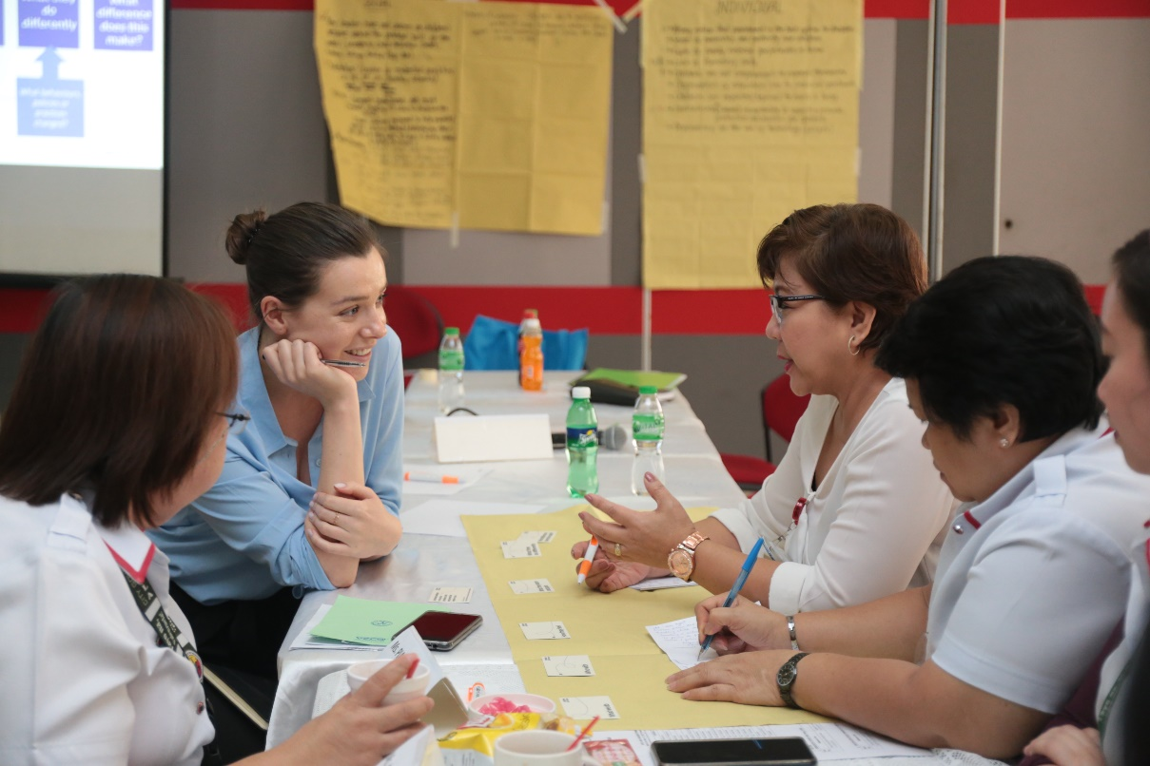
Thinking about impact
Knowledge from research isn’t taken up and used in a rational-linear way, rather people interact with knowledge from their own perspective, experience and context
Morton, S. (2015). “Progressing research impact assessment: A ‘contributions’ approach’ Research Evaluation. http://rev.oxfordjournals.org/content/24/4/405.full

Slide 29
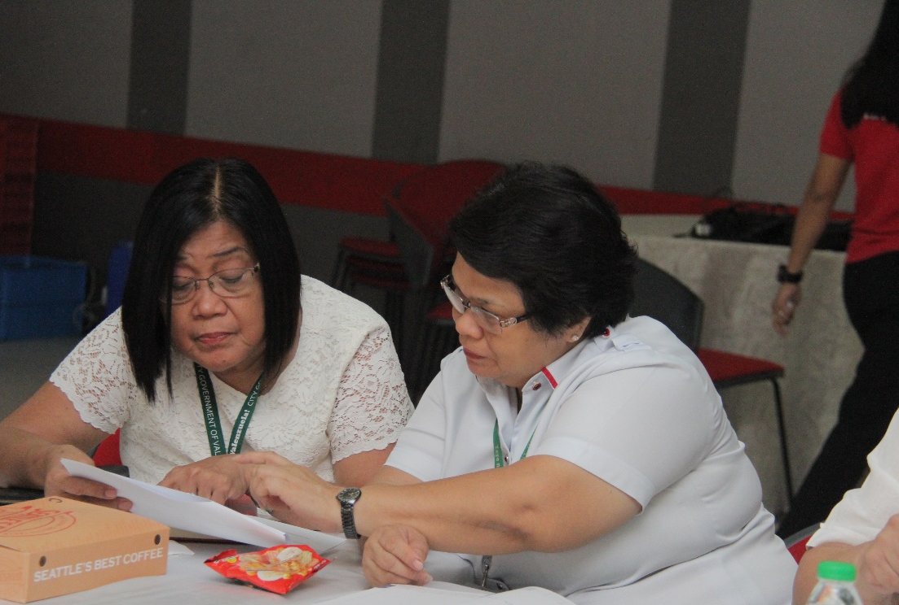
Research use and impact
is a people-based process
Research and knowledge exchange doesn’t directly cause change, - it influences and contributes to change in complex ways

Slide 30
Two seminal papers
Research and policy- it’s not straightforward!
Research and practice – people matter most!
Weiss, C., H (1979). "The many meanings of research utilisation." Public Administration Review 39(5): 426-431.
Gabbay, J. and A. le May (2004). "Evidence based guidelines or collectively constructed mindlines?". Ethnographic study of knowledge management in primary care. BMJ 329. https://www.bmj.com/content/329/7473/1013

Slide 31
Recent reflections from impact studies
Have a vision and intention for impact
Involve research users throughout
Take the time and make the effort
Be honest about failure
Collect data and feedback as you go
https://blogs.lse.ac.uk/impactofsocialsciences/2020/08/27/assessing-research-impact-a-tale-of-7-impact-studies/

Slide 32
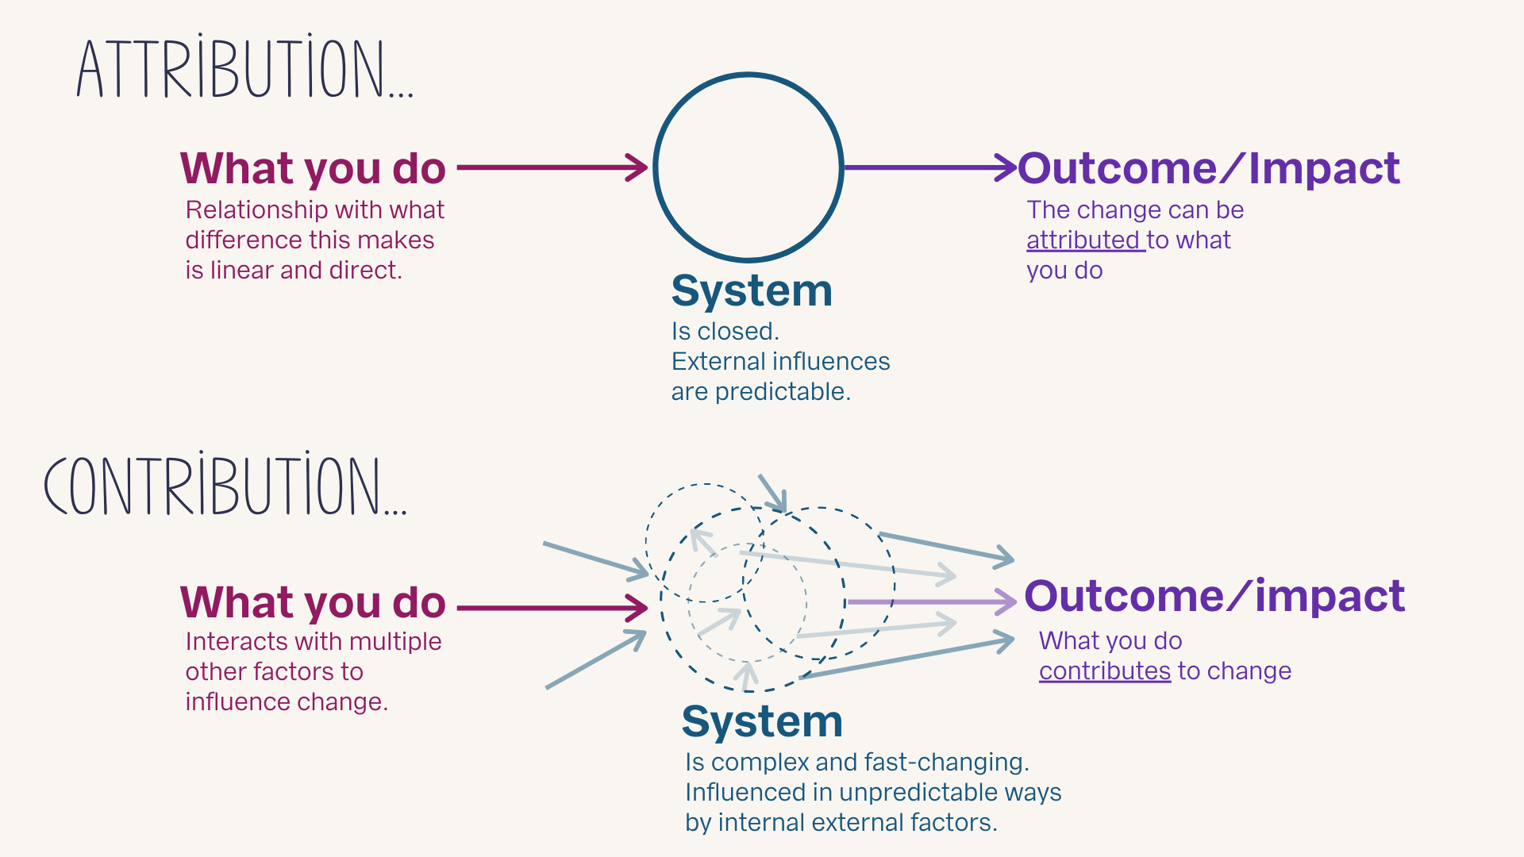
Understanding cause and effect

Slide 33
Competencies and skills
For leaders in science settings
Understanding of impact-orientated working
Practical experience and knowledge of research-users needs and perspectives
Develop and promote impact-orientated systems
For research-users
Critical reflection and analysis
Skills in data interpretation, or support to do this
Orientation and support to use research in practice
For researchers
Understanding of the impact of science
Time and resources to support impact working
Recognition and celebration of impact

Slide 34
The right materials
Enough
time to plan for and work on impact
Ways of managing the information and data needed
Tools that support robust thinking, planning, measuring and reporting for impact
Practical support and materials to do impact well (space, planning, facilitation)
Adequate budget for impact work

Slide 35
We need to skills and tools to:
Plan for impact
Be clear about effective methods for evidence to action
Identify and work well with the people we include and influence
Plan and collect feedback along the way
Assess our impact
Notes:
I have spent years refining and improving methods and tools to help people do this work well – I am going to introduce these now.

Slide 36

How we support impact work
Pioneering thinking about impact
Research Impact Training School
Workshop series for individual research impact organisations/teams
Flexible software
Like SatNav but for outcomes!

Slide 37
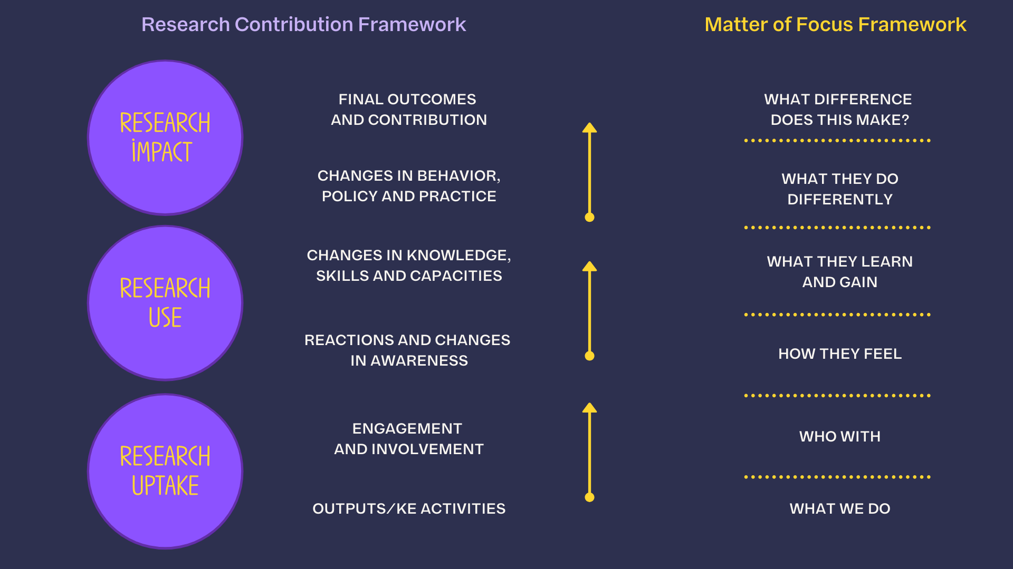
Morton, S. (2015). Progressing research impact assessment: A ‘contributions’ approach Research Evaluation.

Slide 38
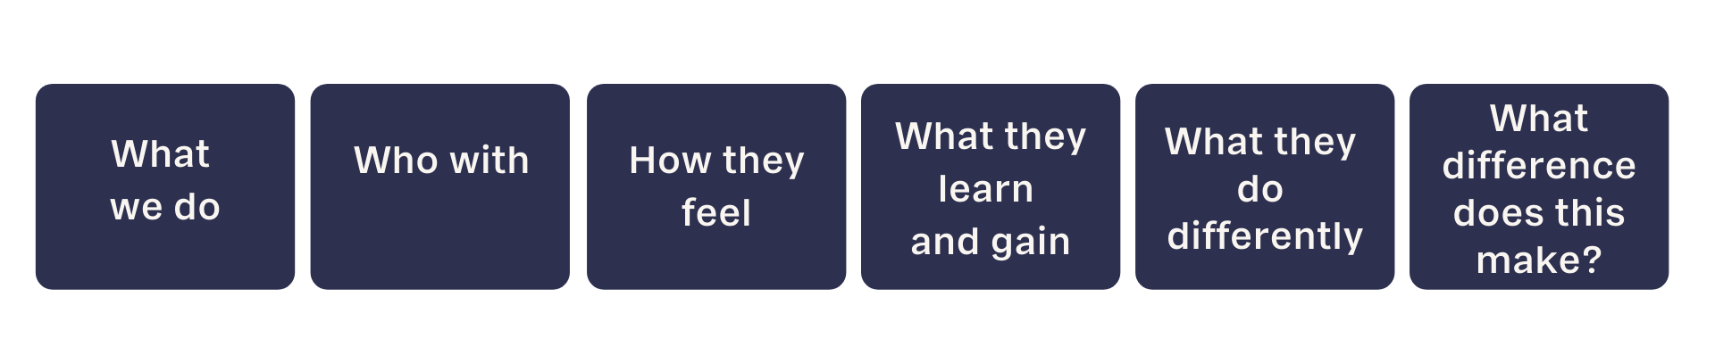
Our approach to pathways for impact
What are the key activities?
Who is engaged and involved?
How do they react? What helps positive engagement?
What knowledge, attitudes, skills and capacities develop?
What behaviours, policies or practices change?
What is better for people or communities?

Slide 39
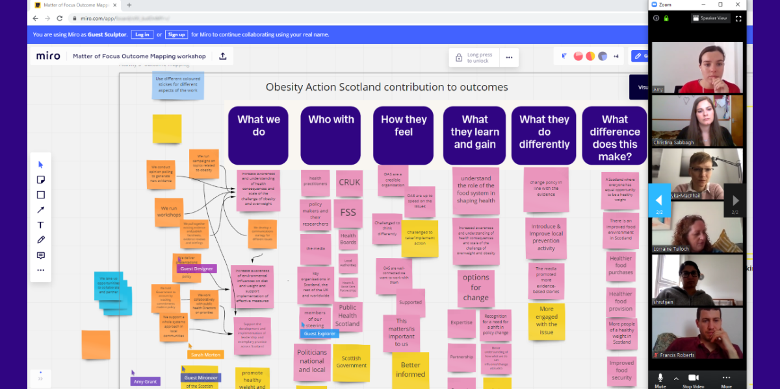
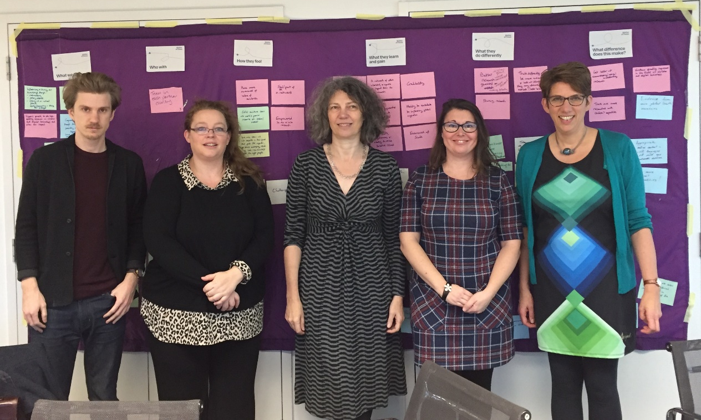
Pathways to impact (in action!)
Virtual outcome mapping with
Obesity Action Scotland March 2020
Outcome mapping with Global Kids Online team,
London 2018

Slide 40
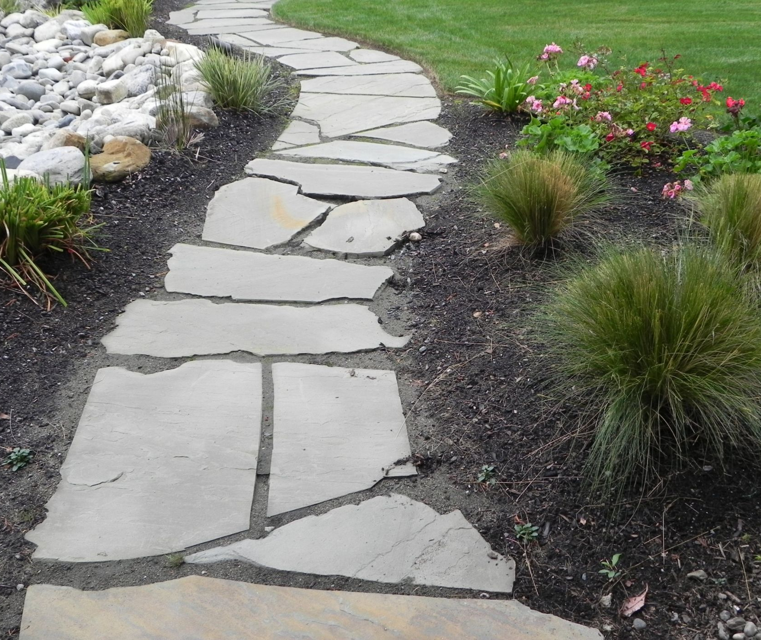
Plotting an impact or outcome map (if done well)
Helps to focus on potential impact
Provides a way of planning for impact
Communicates about what matters to the project or initiative
Provides a structure for thinking and learning about impact
Creates a framework for evaluating impact
Notes:
Lesley

Slide 41

Plot pathways
Identify and collate evidence
Visualise progress
Report on impact
Share with partners

Slide 42
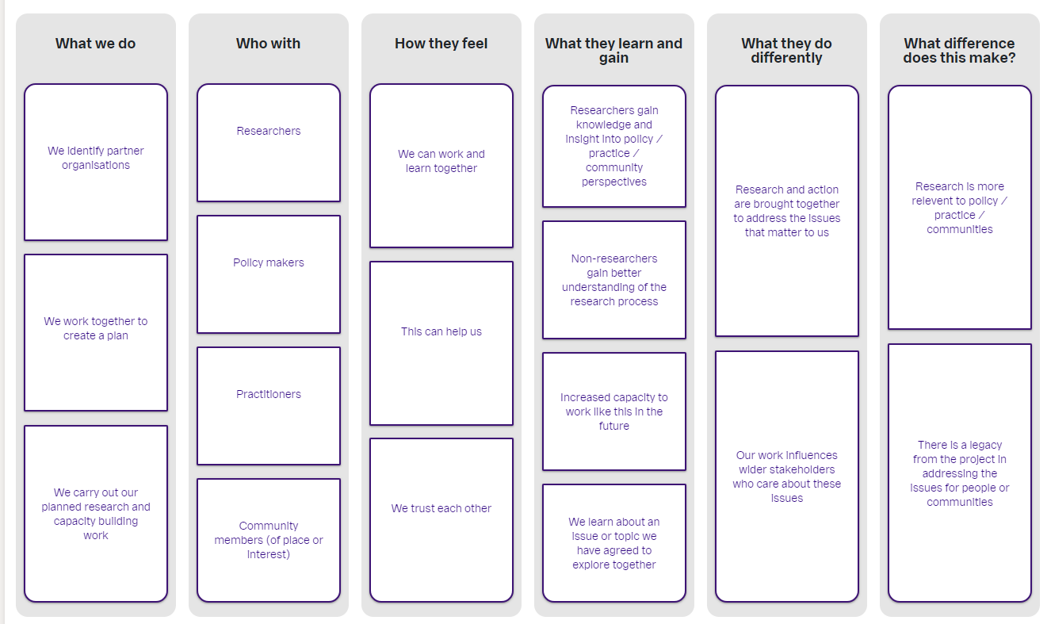
Notes:
Do with other

Slide 43
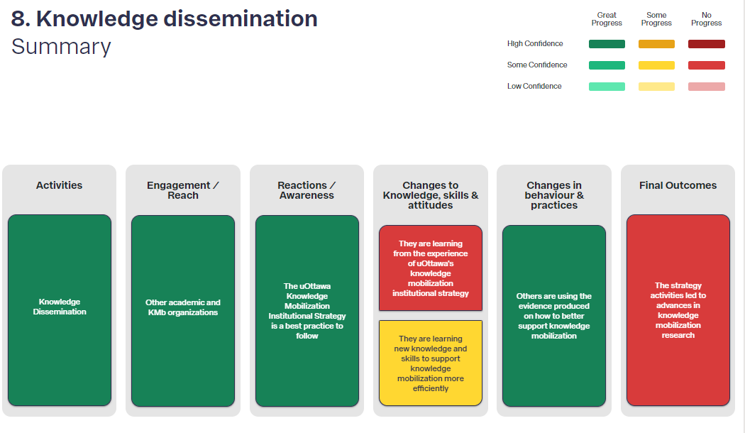
OutNav progress tracking
Notes:
Describe our rating system

Slide 44
Further information
Join our mailing list https://tinyurl.com/yxpzvdmb
Research impact school https://www.matter-of-focus.com/research-impact-school-training/
Join the conversation (Twitter @sasmort @matter_of_focus) and Linked In https://www.linkedin.com/in/sarmorton/)
Keep in touch! sarah@matter-of-focus.com

Slide 45
Impact of Science
23-25 June, 2021
Angus Paterson
Managing Director of South African Institute for Aquatic Biodiversity, NRF, South Africa
#IOS21

Slide 46
Skills required for driving research and innovation impact in the “Blue Economy”.
A.Paterson, J.Pegg and G.Simpson
National Research Foundation – South Africa

Slide 47
South Africa is currently finalising its Research & Innovation Decadal Plan 2021- 2031.
A key component of this strategic plan is ensuring the National System of Innovation (NSI) delivers research and innovation that results in socio-economic impact.
The South African government has identified the “Blue economy” as a key socio-economic driver.
To achieve research & innovation impact will require a different approach by funding agencies such as the National Research Foundation and their associated National Facilities.
The National Research Foundation (NRF) is presently developing a number of policies and systems to give action to its Vision 2030.

Slide 48
NRF VISION 2030
NRF Vision – Research that works for society
NRF Mission – To improve the quality of life of all South Africans through advancing research, science, technology and innovation.
  Transformation Policy
  Research Agenda: Theme approach
  Research excellence policy: Inclusivity, Redress, Impact & Rigour
  Engaged Research Policy: Stakeholder involvement
  Research Impact Policy: Impact orientated

Slide 49
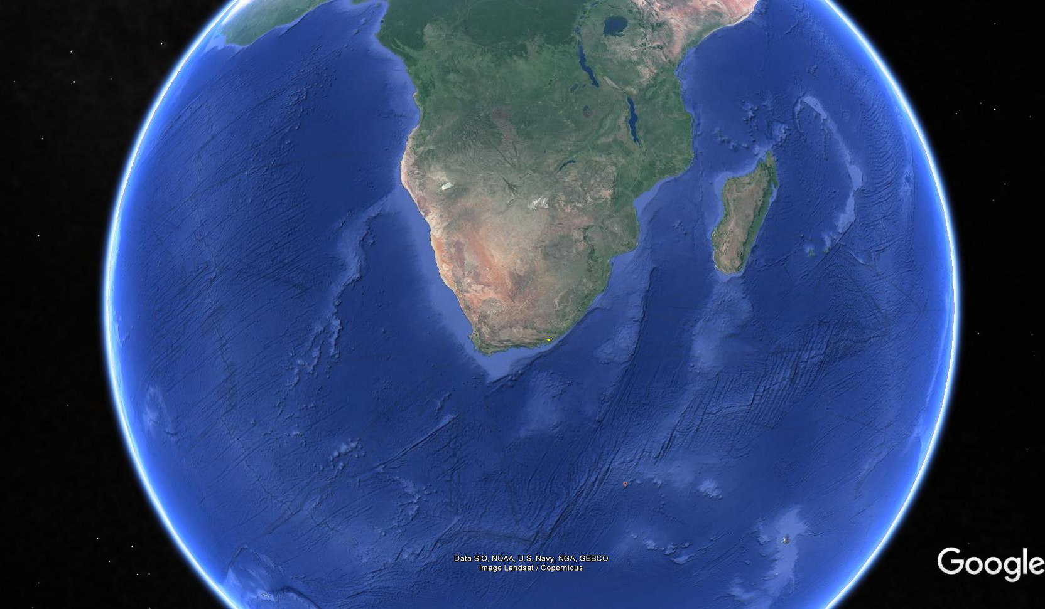

Slide 50
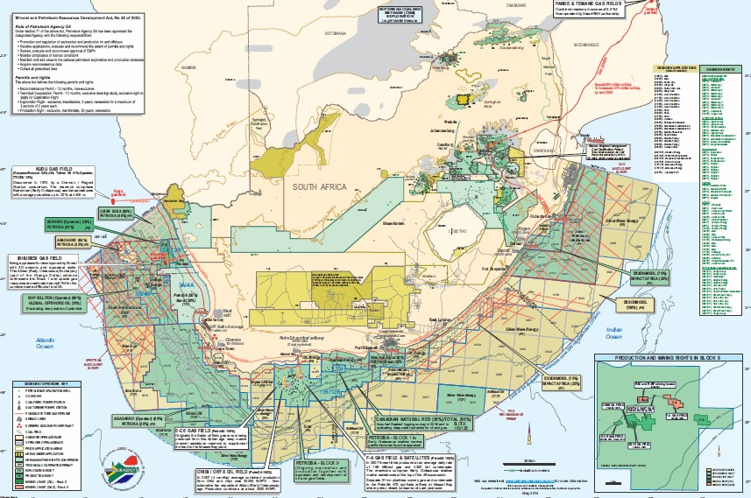
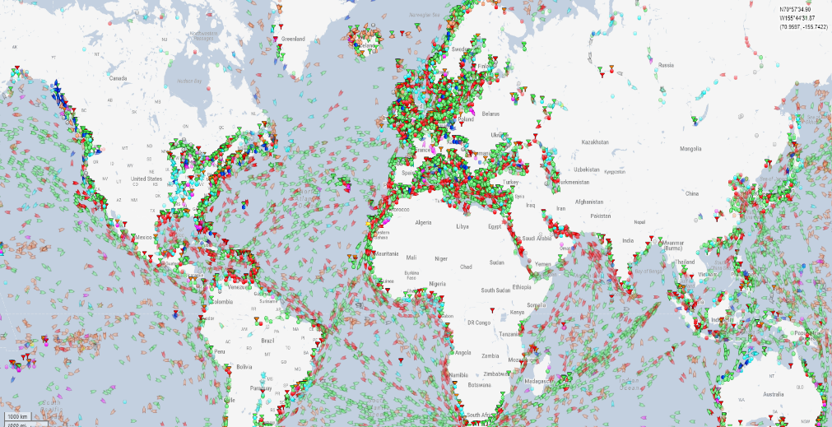
OPERATION PHAKISA – OCEANS ECONOMY
PHAKISA LABS
  Oil and gas
  Transport
  Aquaculture & mariculture
  Governance
  Fisheries
  Mining
  Tourism
BLUE ECONOMY
Complex
Multi sectoral
Disparate Governance
Multiple demands
4IR

Slide 51
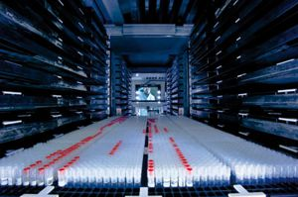
WHAT SKILLS DO WE REQUIRE TO DRIVE RESEARCH IMPACT IN THE
BLUE ECONOMY?
Internal discussion group within SAIAB

Slide 52
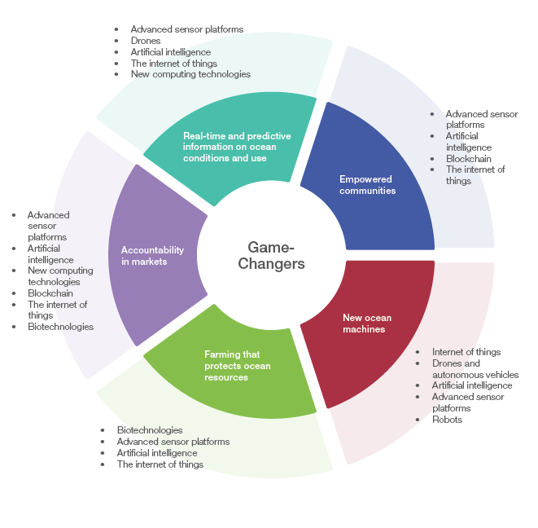
Skills
IT
Engineers
Modellers
Bio-technologists
AI & ML specialists
Maritime technological skills
Ecologists and sociologists
Outcomes & Impact
Drones
Robots
Advanced sensor platforms
New generation farming
Pharmaceutics
Transport systems
Sea floor mining
Oil and gas
Mariculture
WEF - Harnessing the Fourth Industrial Revolution for Oceans

Slide 53

THE KNEE JERK TO DISCUSS SKILLS ASSOCIATED WITH ACTVITIES
Assessment systems
Reward systems
Both Institutional and Individual
EX ANTE
STAGE
EX POST
SPHERE OF CONTROL
SPHERE OF INTEREST
IMPLEMENTATION
Impacts
Inputs
SA has good basic research competencies with pockets of excellence.
SPHERE OF INFLUENCE
How good are we at mobilisation of knowledge, translation into impact?
Outcomes
Activities
Outputs
Are our skills representative of our country?

Slide 54
GETTING TO RESEARCH IMPACT
EX ANTE
STAGE
EX POST
SPHERE OF CONTROL
SPHERE OF INTEREST
IMPLEMENTATION
Impacts
Inputs
SPHERE OF INFLUENCE
Outcomes
Activities
Outputs

Slide 55
SKILLS FOR INPUT TO ACTIVITY
Traditional focus of skills development (What)
  Research rigour
  Peer reviewed paper output
  Infrastructure provision
Planning skills (Who, Why, with Whom)
  Co-creation
  Stakeholder involvement
  Policy alignment
  Redress & Transformation
  Ethics
  Socio-economic impact intentions
  Transferability and actionability
  Review, analyse assess (Ex ante, Ex post)
  Systems associated with planning, review and assessment
  All the above require specialised skills

Slide 56
THE WHO?
REDRESS & TRANSFORMATION
The legacy of apartheid and colonialism resulted in a highly unequal society. These disparities are still all to evident in the National System of Innovation and the “Blue Economy” as to:
  Who undertakes research.
  The ability of some previously disadvantaged Institutions to move from Activity-Output-Outcome-Impact.
  Availability of critical inputs (Resources, Infrastructure, Support, Location, Staff, Networks etc.).
  Scholar - Student- Postgraduate: Under-resourced schooling system and undergraduate training; water and culture; disarticulation from the marine environment.

Slide 57
TRANSFORMATION IS A FUNDAMENTAL PRE-REQUISITE
DSI & NRF
  Directed Bursaries, grants, infrastructure access ACEP - Phuhlisa programme
  Directed redress programmes – Thuthuka and young researchers
  Ring-fenced programmes – Professional development programme
  Redress infrastructure programme - SARIR
  Redress historical Institutional legacy issues – DSI Joint Marine Labs

Slide 58
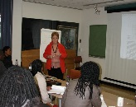
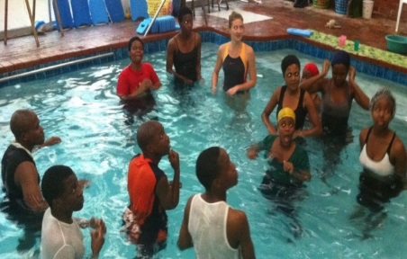
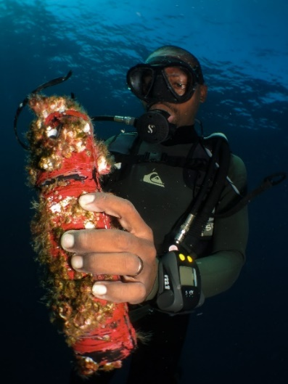
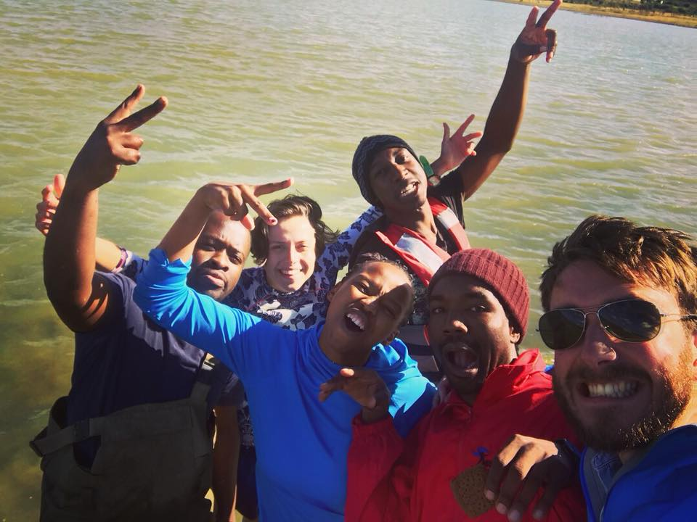
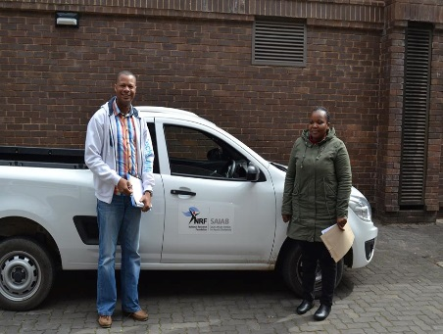
THE IMPORTANCE OF CONTEXT IN TERMS OF SKILLS
Life skills @ SAIAB
Addressing the articulation gap
Numeracy, Literacy, Financial and IT skills
Marine and freshwater familiarisation
Driving
Swimming
Diving

Slide 59
GETTING TO RESEARCH IMPACT
EX ANTE
STAGE
EX POST
SPHERE OF CONTROL
SPHERE OF INTEREST
IMPLEMENTATION
Impacts
Inputs
SPHERE OF INFLUENCE
Outcomes
Activities
Outputs

Slide 60
OUTPUT- OUTCOME – IMPACT
Innovation Chasm - The inability of academic research to reach the market as products and services “the gap between innovators and early adopters and ‘everyone else’” Moore (1991) Crossing the Chasm. Harper Business Essentials
.
Cost of innovation
Difficulty finding collaborators
Lack of end-user knowledge on tech – resistance to take up
SKILLS
Entrepreneurial
Commercial
Legal and patenting
Financial
Policy
Communication
Marketing
Scaling
Proposal Assessment

Slide 61
EX ANTE
STAGE
EX POST
SPHERE OF CONTROL
SPHERE OF INTEREST
IMPLEMENTATION
Impacts
Inputs
SPHERE OF INFLUENCE
Outcomes
Activities
Outputs

Slide 62
IMPACT
Skills required to understand Impact.
What is it?
How is it measured ?
How is at assessed e.g. REF?
How do you plan for impact?
What systems are available to optimise the chance of Impact
Getting past the challenges of understanding impact: Time, Attribution, Public vs Private good, scale etc?
Impact and reward systems –
  NRF Rating systems – output orientate
  HEI Government financing - Output orientated

Slide 63
SKILL CHALLENGES - SIZE, SCALE, AGENCY, NETWORKING, RESOURCING
Size and resources
Government Research Institutes, HAI, HDI, NGO, Business R&D
  Top SA Higher Education Institutions have good commercialisation and outcomes skills and capability.
  CSIR resourced with end to end skills and capability.
  How do you mobilise knowledge/drive pathways to impact in the less resourced entities that have major skills gaps? These entities are normally activity orientated with limited end to end capability?
Pathway to impact - accelerators – INSTITUTIONAL SKILLS & Systems
  In-house capability
  Technology Innovation Agency (TIA)
  Phakisa Labs (Business, Government Agency, Sector stakeholders)
  DSI/NRF Marine Industry Interaction Platform
NSI design for impact and Innovation – SYSTEM SKILLS
  Clear priorities and missions
  Integration
  Co-governance
  Institutional landscape
PARADIGM SHIFT

Slide 64
SYNOPSIS
DSI Decadal Plan and NRF Vision 2030 are purposefully disruptive. New skills will be fundamental
Impact is a paradigm shift in thinking – Resources will be required to develop and mobilise skills
Deep investment in NRF skills and systems to drive pathways to impact
NRF must develop internal and external skills
    Impact literacy
    Holistic thinking
    End to end sector knowledge Theme approach and management
    Inter and trans disciplinary funding instruments
    Stakeholder involvement (Civil, Government, NGO, Business)
    Redress
    Impact reward and evaluation – Rating system
    Ex ante and ex post evaluation of Impact

Slide 65
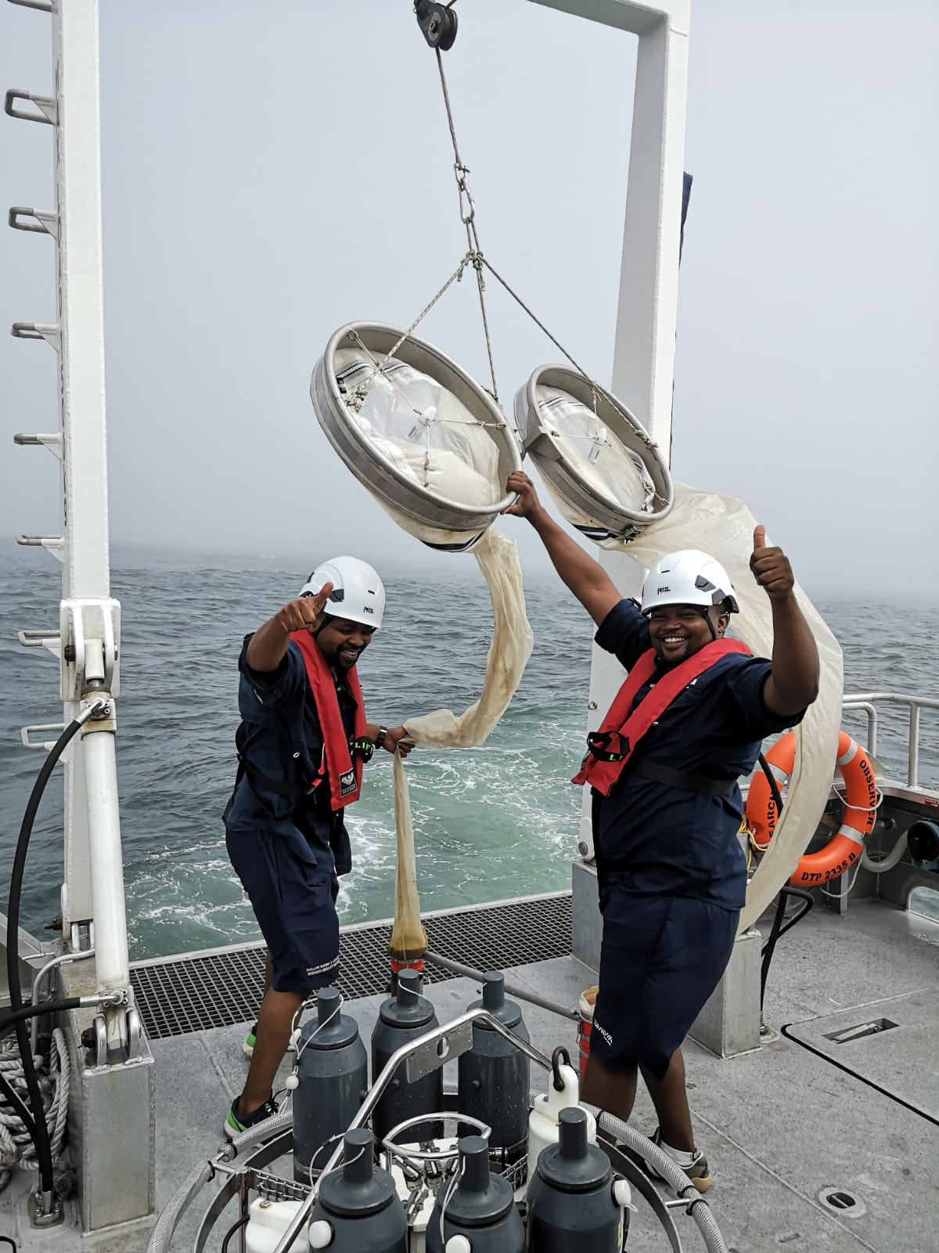
BLUE ECONOMY- SKILLS
Transform the skills base – Race and Gender
Ensure NSI has the requisite “activity” level skills for the 4IR and SDG driven future (Computing, AI, Biotechnology, Genomics and metagenomics etc.). Existing pockets of excellence must actively network and collaborate with HDI’s
Planning and mobilisation skills
  Identify clear mission driven priorities
  System coherence
  Networking
  Collaboration
  Stakeholder
Bridging the chasm skills
  Entrepreneurial
  Commercial
  Legal and patenting
  Financial
  Policy
  Communication
  Marketing
  Scaling
  Proposal Assessment

Slide 66
Impact of Science
23-25 June, 2021
Thank you
#IOS21

